Slide 1


Green Pace
Security Policy Presentation
Developer: Shaelyn Turner
CS 405 Secure Coding
Project Two

Slide 2

OVERVIEW: DEFENSE IN DEPTH
Defense in Depth (DiD) is a security strategy that utilizes multiple security measures. This strategy utilizes different layers of security to create protection from potential attacks.

Slide 3
THREATS MATRIX
Likely Considered to have a high probability of occurring | Priority These threats are highly important and require urgency
Low priority Not considered an urgent priority | Unlikely Considered to have a low probability of occurring

Slide 4
10 PRINCIPLES
Validate Input Data
Heed Compiler Warnings
Architect and Design for Security Policies
Keep it Simple
Default Deny
Adhere to the Principle of Least Privilege
Sanitize Data Sent to Other Systems
Practice Defense in Depth
Use Effective Quality Assurance Techniques
Adopt a Secure Coding Standard

Slide 5
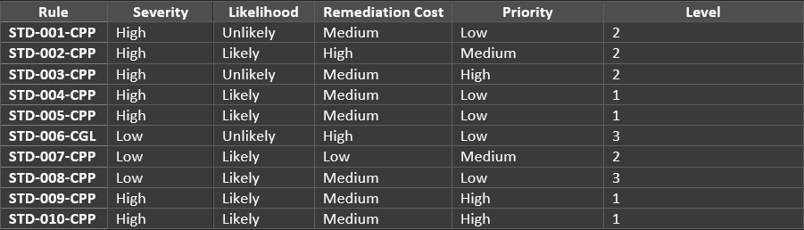
CODING STANDARDS
[STD-010-CPP] Strings: Guarantee that storage for strings has sufficient space for character data and the null terminator
[STD-009-CPP] Expressions: Do not read uninitialized memory
[STD-003-CPP] String Correctness: Range check element access
[STD-002-CPP] Data Value: Use valid references, pointers, and iterators to reference elements of a container
[STD-007-CPP] Exceptions: Handle all exceptions thrown before main() begins executing
[STD-004-CPP] SQL Injection: Do not store an already-owned pointer value in an unrelated smart pointer
[STD-005-CPP] Memory Protection: Do not access freed memory
[STD-006-CGL] Assertions: Use a static assertion to test the value of a constant expression
[STD-008-CPP] Exceptions: Handle all exceptions
[STD-001-CPP] Data Type: Do not cast to an out-of-range enumeration value

Slide 6
ENCRYPTION POLICIES
Encryption at rest consists of data that is on something like a disk or hard drive. This data is stored on different devices and not within the system itself. The policy applies as sensitive data should be stored separate from the system to ensure its confidentiality. This policy is helpful at preventing any unauthorized access from taking place. The data is also encrypted and must be decrypted to access any of the information.
Encryption in flight refers to data that is transferred throughout networks. This policy issued to protect the data as it is being sent between two different networks. The data is encrypted as it is being sent and is decrypted once it is received by the authorized user. Both the sender and receiver utilize and encryption key to accomplish this.
Encryption in use refers data that is actively being used. This policy is designed to protect the data while it is being accessed/ used. This policy applies as its purpose is to protect this data from any kind of unauthorized access. When data is being utilized it is the most vulnerable to security risks.

Slide 7
TRIPLE-A POLICIES
Triple-A Policies refer to authentication, authorization, and account.
Authentication: Ensures the person accessing the system has the appropriate credentials to gain access. We can easily identify the user.
Authorization: Ensures users that are authenticated only gain access to authorized data. Verifies the amount of access for users.
Accounting: Monitors the system and keeps track of any activities/ changes happening within the system. We can see who is accessing what and when.

Slide 8
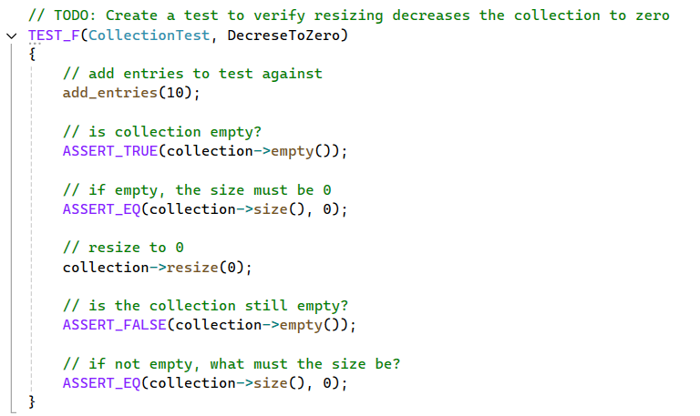
Unit Testing

Slide 9
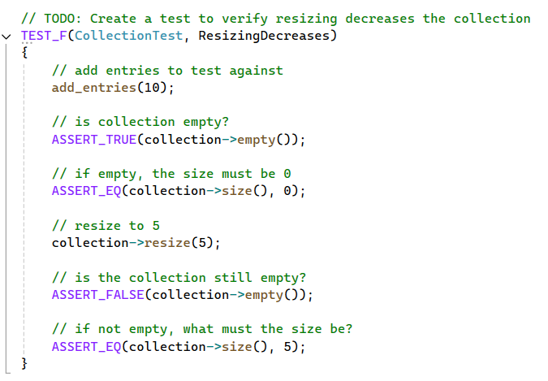
Unit Testing

Slide 10
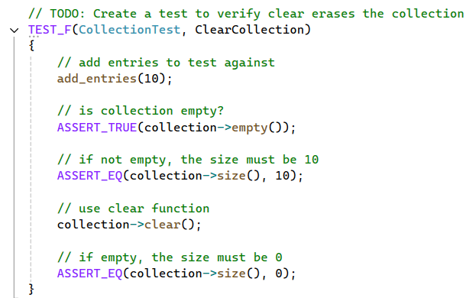
Unit Testing

Slide 11
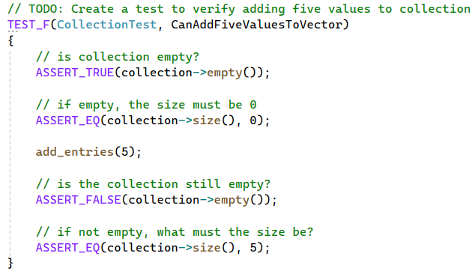
Unit Testing

Slide 12
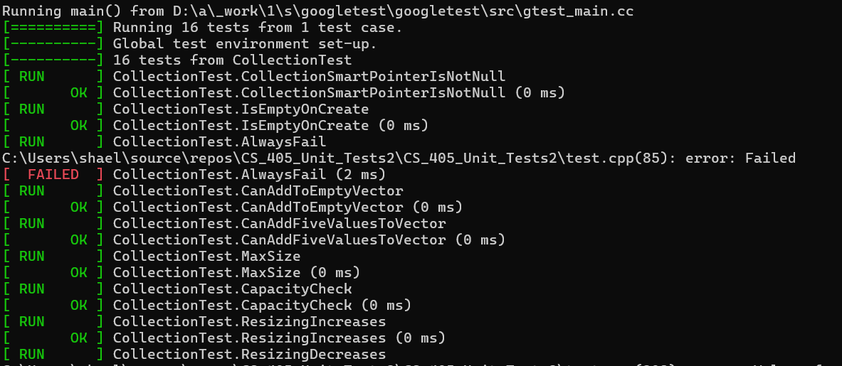
Unit Testing

Slide 13

AUTOMATION SUMMARY

Slide 14
TOOLS
Snyk: Compatible with multiple different IDE’s and can offer real-time vulnerability assessments during the building phase.
Static Application Security Testing (SAST): SAST is used during the verification phase and will scan the code to help to identify vulnerabilities. It will also provide instant results to developers.
Runtime Application Self-Protection (RASP)/ Aikido: RASP is used during the monitor and detect phase. RASP security can keep the application protected as it monitors the application as it runs.. RASP tools can help protect the application and give developers insight into attacks.
RASP : Also used during the respond phase as it will help the developers understand the attacks and prevent others from happening. Utilizing automation can greatly improve the applications security.

Slide 15
RISKS AND BENEFITS
Acting Now
Waiting
Strategies/ Steps
Risks
Don’t have all the information
Financial costs
Quality issues due to like of time
Benefits
Quick solutions
Limit the amount of damage
Risks
Gives time for attacks to occur
Issues can continue to escalate
Financial costs
Distrust with users & stakeholders
Benefits
Time to gain information
More prepared
Gather as much information as possible before beginning
Develop risks assessments and mitigation strategies
Continued monitoring of the system
Decide if there is time to wait or if the problem needs to be dealt with quickly
Create a plan with specific steps/ responsibilities

Slide 16
RECOMMENDATIONS
Standards
Possible Gaps
Regular audits and monitoring
Utilize testing early and often
Perform risk assessments
Continue training to stay up to date with standards
Utilize automation
Vulnerability Management
Employee Training
Outsource testing to find security issues

Slide 17
CONCLUSIONS
Regular audits and monitoring of the system can find vulnerabilities and prevent future problems.
Implement Corrective and Preventive Actions (CAPA) can help to maintain the program. Also, will help to identify areas of improvement throughout the system.
Keep in mind the 10 principles when developing
Case Study for CAPA
“An IT services provider – there was an ongoing problem with software bugs causing system crashes for clients. Their CAPA program helped them investigate the root causes behind these issues and establish preventive measures like conducting thorough testing before deploying updates or patches” (Team, 2023).

Slide 18
REFERENCES
SEI CERT C++ Coding Standard - SEI CERT C++ Coding Standard - Confluence. (n.d.). Wiki.sei.cmu.edu. https://wiki.sei.cmu.edu/confluence/pages/viewpage.action?pageId=88046682
Team, T. oboloo. (2023, November 19). CAPA in Quality Management: Corrective and Preventive Actions Explained - oboloo. Oboloo. https://oboloo.com/capa-in-quality-management-corrective-and-preventive-actions-explained/
Vicente, V. (2024, February 15). Risk Assessment Matrix: Overview and Guide. AuditBoard. https://www.auditboard.com/blog/what-is-a-risk-assessment-matrix/

